Slide 1
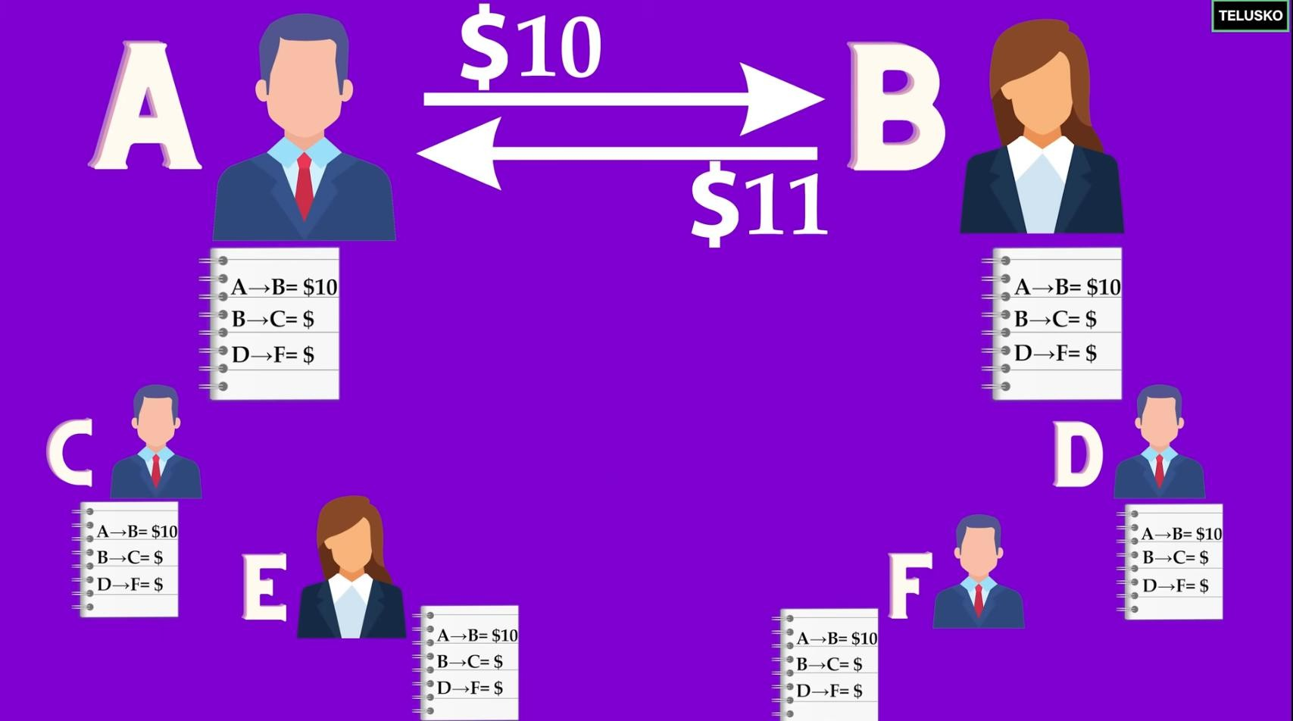
Introduction to Block-Chain key-Concepts to Understand::
a. What is Web3 have any credit on how they are using it(security)=> no control of your own data.
Get to know Torrent Networks works
In Web2 Your data on free Google services or YouTube are being traded while you thought its free and you don’t have any credit on how they are using
it(security)=> no control of your own data.
The applications that are running on distributed networks(DAPs)
-
- On Web3 you own your data.

Slide 2
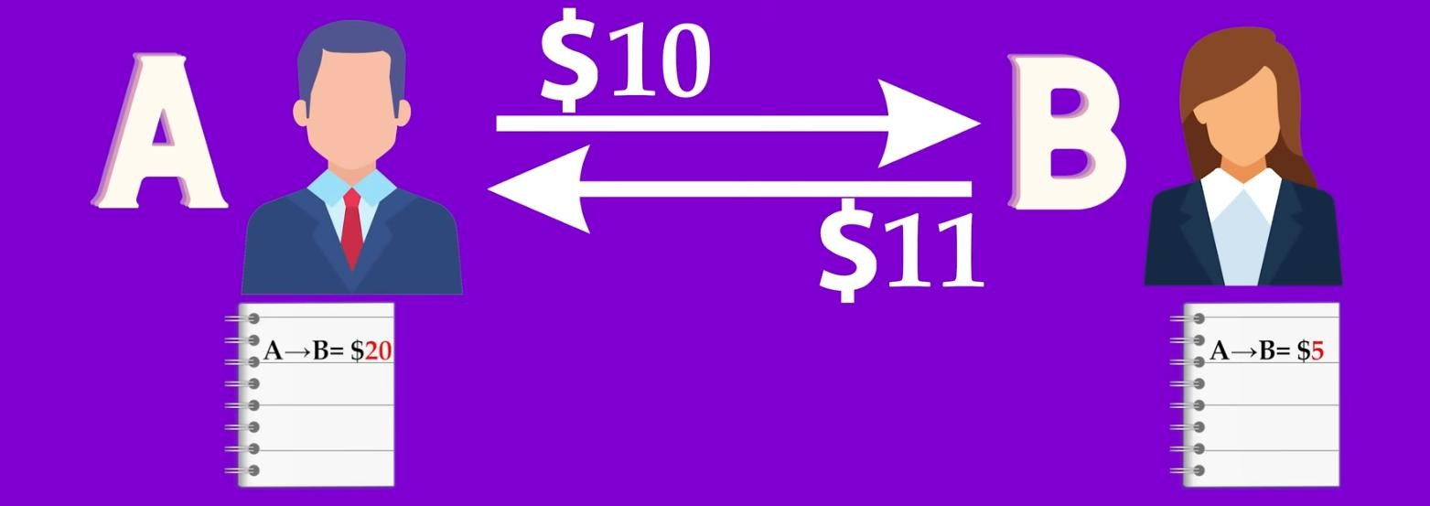
-
b. What is Block-Chain?
Moving from Centralized->Decentralized (who will control our own data?).
Data on Web3 is immutable (everyone can see if someone want to make forgery).
If someone try to modify data as a miner on web3 we can notice him/her a kick him out of our network.

Slide 3
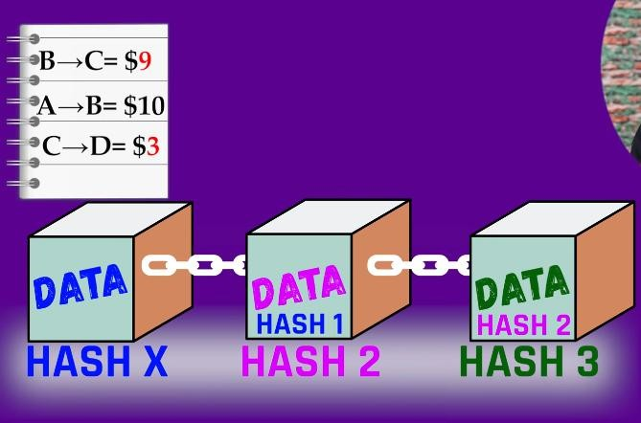
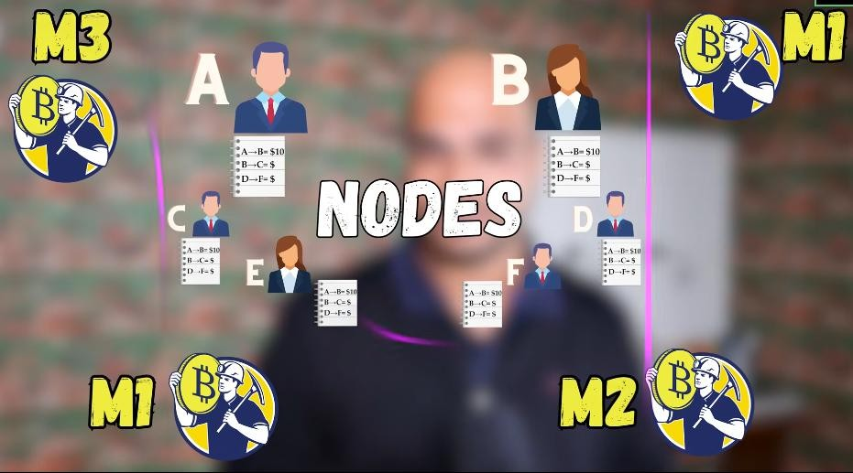
c. Why Block-Chain (who, why, and what are prerequisites)
Block chain provide Trust
Prerequisites are cryptography and distributed computing.

Slide 4

d. Cryptography.
Confidentiality (none can see that data)
Integrity (none can modify our data)
Non repudiation. (proof of message transferred).
Authentication. (None must send message to someone’s else behalf).
Crypt(Hidden)-Graphy(Written)=>Encryption

Slide 5
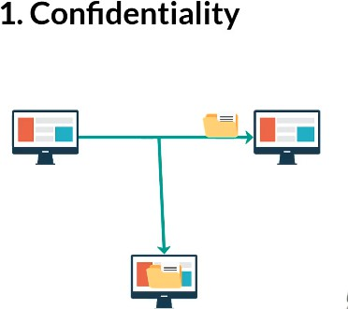
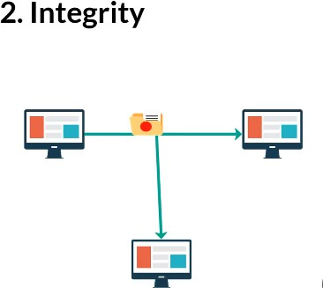
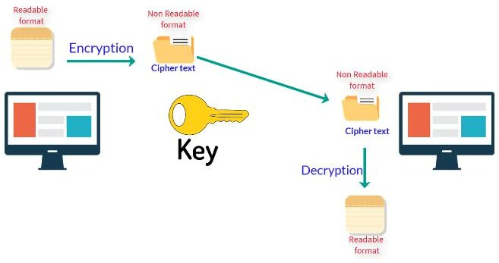
e. Types of Cryptography
Symmetric-Key Cryptography (same key=> tedious).
As number of user increase we need to increase number of keys..
Asymmetric-Key Cryptography (public and Private key)

Slide 6
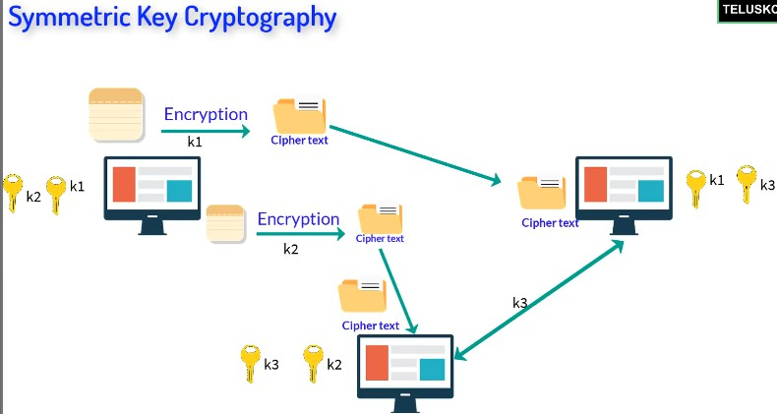
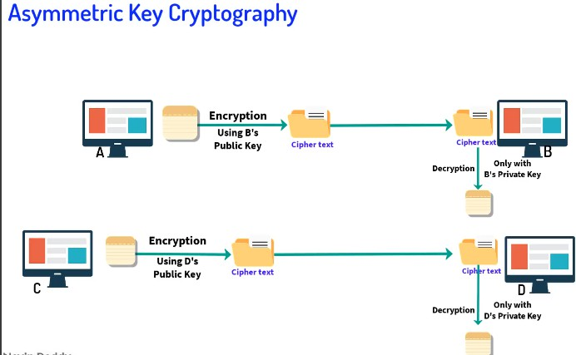
f. Digital Signature. (solve problems in network)
- We need to know who is exactly sending the data (like written letter signed to confirm its you).

Slide 7
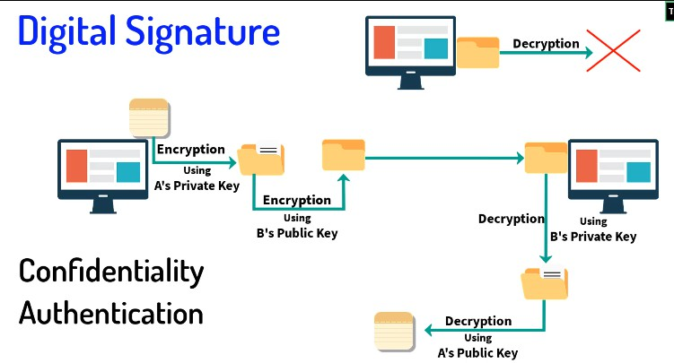
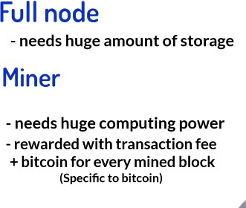
g. Nodes in Block Chain.
Full Node needs at least good processing CPU’s and GPU’s in 188GB and it verify and store block-chains.
Partial Node can be like PC/cellphones to download the app and use to trade (on purpose).
h. Hashing in Block-Chain
You cannot get data back in hashing like encryption-where it uses decryption.
We can use algorithms like MD (Message Digest), SecureHashAlgorithm(SHA).

Slide 8
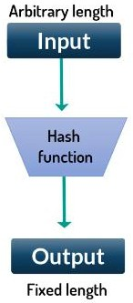
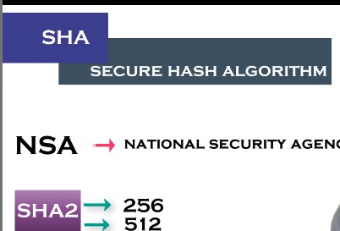
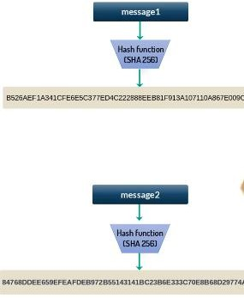

i.
MerkleTree_MerkleRoot.
- We need to have only one hash for each transaction.

Slide 9
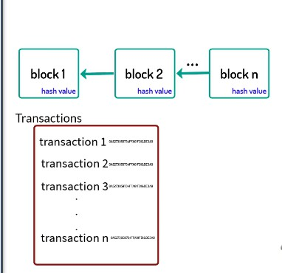
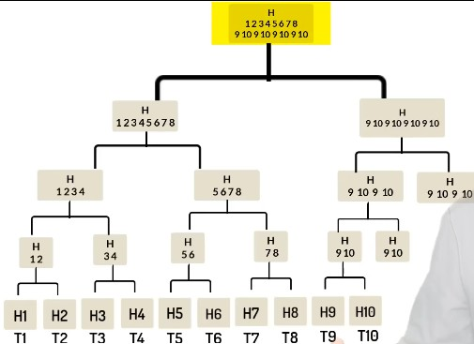
j. Blok_chain_Technology_Architecture
Consensus Algorithm give nodes to verify your proof of work
To add or modify data to block chain you need 50% majority.

Slide 10
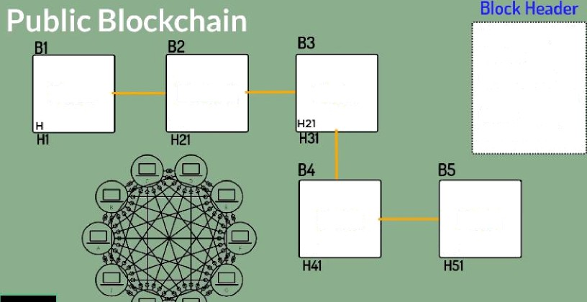
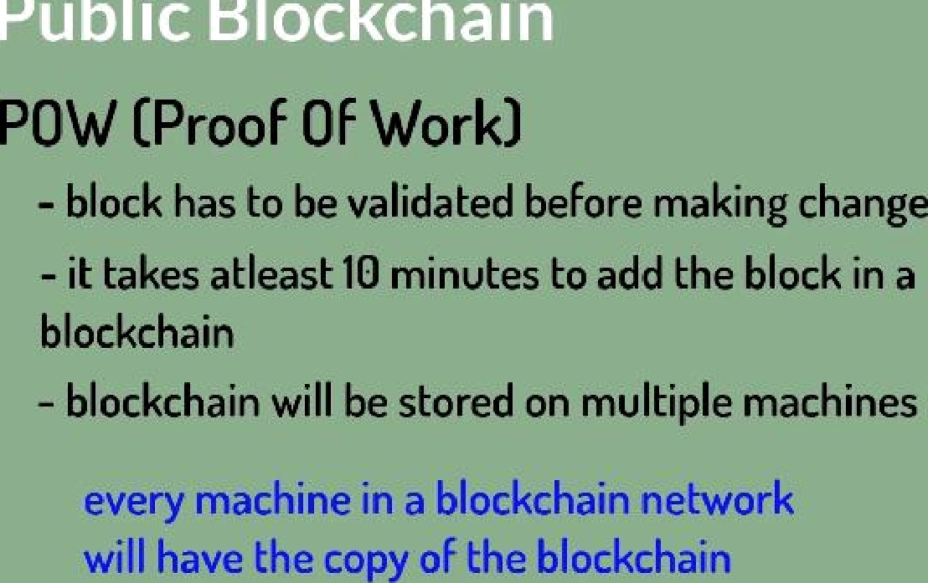
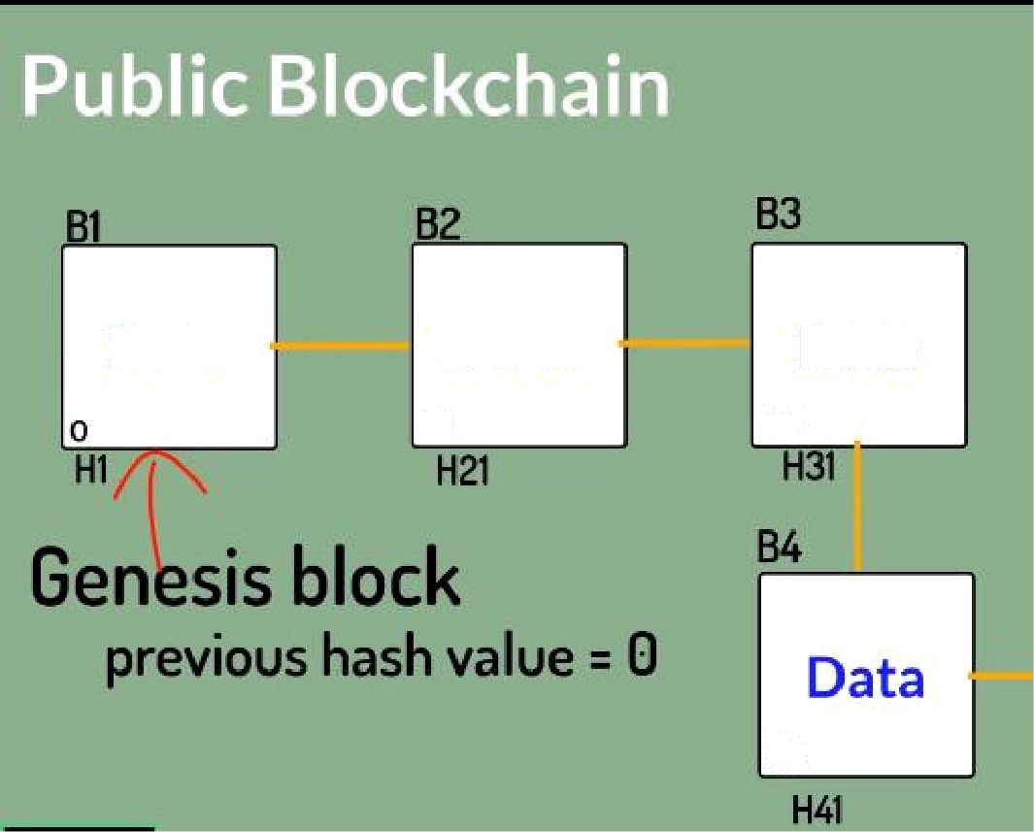
Timestamp Version Herkle Root
Difficulty Target
Nonce
Previous Hash
Data
Data 1
Hl
Data
Data
H3J
Data
H41
Data
Data 1
HJ
Data
H2
H3

Slide 11
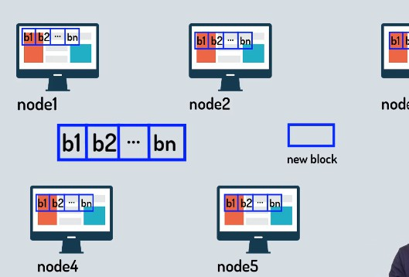
k. Types of Block chain
Public Block-Chain is open and everyone can be part of it (slow we need POW).
Private Block-Chain is specifically for a single company (fast-> no need of POW).
Federated Block-Chain is group of people /companies.
l. Consensus in Block-Chain
We give miners (not malicious) puzzle to solve and use their computing power, one who wins, add the block-to chain and got rewards. And using consensus we can agree on some state on block-chain network.
Algorithms like POW(work),
POS(stake) where too much investors(coins$) got trust.
POET (Elapsed time), POD (deposit), POC(capacity)
m. Proof of Work. (Bitcoin)
- There’s is a competition of math-calks who win add block in chain and get rewards.

Slide 12
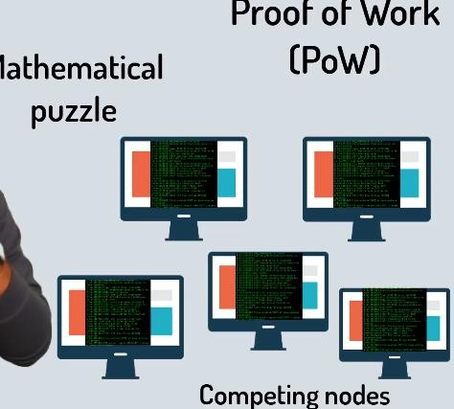
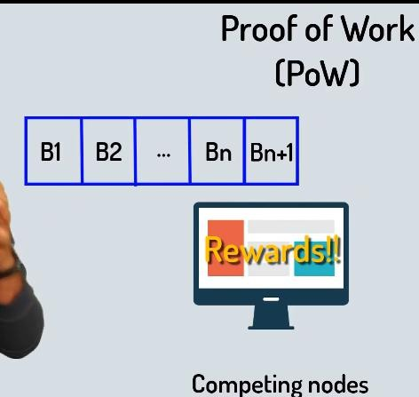
- Issues (spending too much idle power, and may be 51% of nodes are malitious)
n. What is Etherium.
BitCoin is peer-to-peer electronic cash system.(CryptoCurrency)
To write apps/softwares we have Etherium(DApps)
To be able to use crypto currency in ethereum we need Ether.

Slide 13
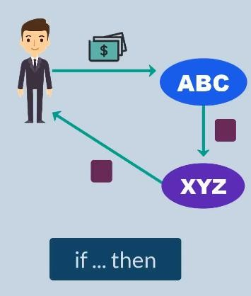
- Def: it’s simply a platform where you can build your decentralized applications/softwares, it also has its own cryptocurrency Ether.
m. Smart Contracts(Trust/secure).
Prepaid transactions trust issues.
Are lines of codes built and run on ethereum networks to make contracts.
o. Drawbacks of Block-Chain. (mostly public)
Complexity of many terms & algorithms and even technology.
Slow Speed [VISA handle 1000s transactions/sec] ! [Bitcoin handles 7-10 trans/sec]./day
Wastage of resources to handle their algorithms
Security/Privacy (the data is there in block chain; everyone can see it).
51% attack. ( it can be hacked).
But on private we can handle some of these issues.
p. What is HyperLedger.

Slide 14
It is not block chain, company or cryptocurrency as well.
It is a project. Hosted by Linux foundations and accepted from other big-techs(Amazon,Google,IOT,Industry,…).
Umbrella or Greenhouse for block chain open source products. (B2B) in which you can build block chains.
q. What is NFTS?
NFTs (Non-Fungible Tokens) are like digital ownership certificates that prove you own a unique item on the blockchain.
Real-Life Example:
Imagine you buy a rare, one-of-a-kind trading card (like a special edition Pokémon or sports card). Even if other people have similar cards, yours has a unique serial number proving it’s the only one of its kind.
Now, in the digital world, NFTs work the same way! Let’s say an artist creates a
digital painting and turns it into an NFT. When you buy that NFT:
✅ You own the original digital artwork (even if others copy or download it).
✅ Your ownership is recorded on the blockchain (a secure public ledger).
✅ You can sell or trade it, and the blockchain will track ownership changes.
So, NFTs make digital things (art, music, videos, virtual land, etc.) unique and ownable, just like physical collectibles. 🚀
-
Thanks!!!!!!!!!!!!!

